Slide 1
(NBAC TSC Governance)
18 August 2022
Kamran Atri

Slide 2
OASIS Technical steering committee (TSC)
The PGB shall form a Technical Steering Committee (or TSC) by a resolution of the PGB. A Project’s TSC members shall be composed of the persons, selected in the manner, and chaired by such person as is provided by that resolution. The PGB must create and publish process documentation for each TSC, outlining the requirements for joining and voting in that TSC, consistent with these Rules (including Section 10), and shall specify whether the Chair(s) of the TSC are selected by the PGB, or by that TSC’s members.
The TSC shall have the duties to advise the PGB and such others as are specified by the PGB, so long as consistent with these Rules and OASIS policies.
he following activities may not be delegated by the PGB, although it may consult with any TSC regarding them at the PGB’s option: election or termination of PGB Chairs, approval of any Releases, Group Releases, Project Specification Drafts, Project Specifications, and approval of Candidates for OASIS Standards or external submissions.
TSC members must have signed and submitted an individual CLA, and if appointed by an entity, that entity must have signed and submitted an entity CLA. A list of TSC members shall be maintained and posted at the general information web page designated by OASIS for the Project. An individual may resign from TSC membership at any time, by notifying the Open Project Administrator and the Chair(s) in writing.
Reference - https://www.oasis-open.org/policies-guidelines/open-projects-process/#chairs-maintainers-technical-steering-committees

Slide 3
NBAC TSC
Scope
Coordinate, harmonize and unify NIEM Domain’s content as it relates to the NIEM data model and the code-list
Safeguard NIEM data model core content
Identify, validate and on-board new NIEM domains
Advise, and support the Project Governance Board (PGB) on matters relating to business architecture and requirements of NIEM.

Slide 4
NBAC TSC
Responsibilities
Facilitate construction, maintenance, and use of a business architecture framework, model, code, and other NIEM related documentations
Manage the harmonization process
Develop & package release candidates
Manage the NIEM Core
Serve as forum for NIEM Domains
Establish tiger teams and subcommittees
Onboard new domains, vet new data model content
Provide training
Document SOPs
Shephard release candidate through PGB evaluation & acceptance
Assess NIEM domain maturity, vitality, & health

Slide 5
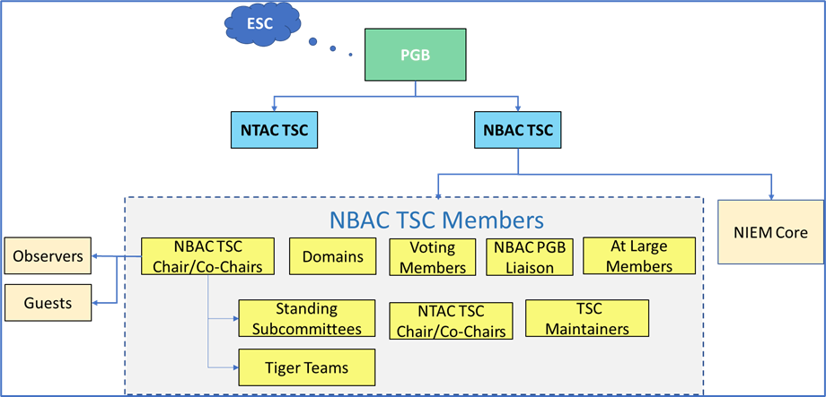
NBAC TSC
Membership
NBAC Chair/Co-Chairs
Domain Stewards
Domains
Voting Members
NTAC Co-Chairs
TSC Maintainers
NBAC PGB Liaison
At-Large Members
Tiger Teams
Subcommittees

Slide 6
Voting Members
The NBAC voting members include:
NBAC Co-chairs
Domains are allowed two voting members appointed by the domain steward or as specified in a domain charter.

Slide 7
Members
At Large Members – NIEM stakeholders/Communities of Interest (CoI) unaffiliated with a specific domain may participate as At-Large members. Members need not be aligned to a formal domain to create NIEM exchanges or participate in the NBAC TSC.
TSC Liaison - The NBAC TSC Liaison to the PGB is appointed by the NBAC TSC co-chairs with consent of the PGB. Nominees can be submitted by any individual. The NBAC TSC Liaison serves a nominal 2-year renewable term at the discretion of the NBAC co-chairs.
TSC Maintainer - When a NBAC TSC Maintainer (hereafter referred to as NBAC Maintainer) is appointed to manage a NBAC GitHub repository, that Maintainer may serve in the dual role as TSC Liaison.

Slide 8
Domain Steward responsibilities
Appoint domain voting members (2 maximum)
Understand OASIS rules and NIEM Open governance
Maintain a data dictionary
Maintain a domain roster and mailing list
Perform outreach to domain CoI stakeholders
Draft, publish, and maintain procedures for domain governance and processes related to domain data model and code list release management
Participate in domain content harmonization
Provide domain support to the NBAC TSC including annual reporting of progress, plans, requirements, and achievements
Provide Domain support to the NIEM Technical Architecture Committee (NTAC) TSC production of technical specifications, requirements, tools, and associated artifacts.
Provide ongoing identification of data requirements based on data exchange modeling and development efforts.

Slide 9
DECISIONS
For most decisions, the NBAC operates by lazy consensus. The NBAC may, at its own discretion, delegate authority on minor decisions to Maintainers in the community, NBAC tiger teams, standing subcommittees or members
NBAC acceptance of Harmonization Process recommendations
Endorsing NIEM award nominations for PGB approval
Approving the NBAC Annual report.
Decisions on the following items must be made based on a Simple Majority Vote
Nominating new domains for PGB approval
Approving minor release candidates for submission to PGB
Approving major release candidates for submission to PGB
Recommending work to the PGB for promotion to the standards track
Appointment of new Maintainer

Slide 10

Lazy Consensus
Lazy consensus means that when you are convinced that you know what the community would like to see happen, you can assume that you have consensus in favor of the proposed work and can get on with it. You don’t have to insist people discuss and/or approve your plan, and you certainly don’t need to call a vote to get approval. You just assume you have the community’s support unless someone says otherwise.
Apache Community Development - Lazy Consensus

Slide 11


Questions & Answers/ Actions ITEMS
Mr. Kamran Atri & Mr. Thomas Krul Facilitators

